Slide 1

Machine Learning Project
Sagar Kumar Wadhwani
MM20B053

Slide 2
Abstract
INPUT : Compositional Data of molecules (89 features) 4560 Datapoints
OUTPUT : The Curie Temperature (Target)
To Create ML Models that can predict the curie temperature from compositional data of compounds.

Slide 3

Prediction of Curie Temperature
High-performance permanent magnets with a high Curie temperature, containing less critical materials, are integral to zero-carbon energy solutions.Building a machine-learning model trained over available experimentally measured Curie temperature values to predict the T_{C} of multicomponent magnetic materials is a important first step to find such materials.
High-performance permanent magnets with a high T_{C} are critical in a wide variety of current and emerging applications, including wind energy, data storage, electric vehicles, magnetic refrigeration, etc . Compounds of magnetic lanthanides with 3d magnetic metals, e.g., Nd₂Fe₁₄B and SmCo₅, possess a highly desired combination of electronic and magnetic properties such as a high T_{C}, large saturation magnetization, and strong magnetic anisotropy, making them the best available permanent magnetic materials known today, and the interest in them has continued unabated in recent years. Unfortunately, these high-performance magnets contain critical elements, such as Nd, Dy, or Co. Considering the anticipated increase in the number of electric vehicles and the use of wind power generators, the use of critical materials in permanent magnet production puts significant stress on the supply chains and threatens the security and sustainable growth of the energy-hungry modern world. Thus, there is a growing demand to both discover new materials that do not contain critical elements and also better understand the underlying physics of the existing ones to reduce the content of critical materials in high-performance magnets without compromising performance.

Slide 4
Machine Learning Pipeline
Data collection (from combined github database 4560 ferromagnetic compounds)
Data cleaning (Normalisation)
Visualize Data
Create ML models
optimize hyperparameters of model
cross-validate the model
Conclusions

Slide 5
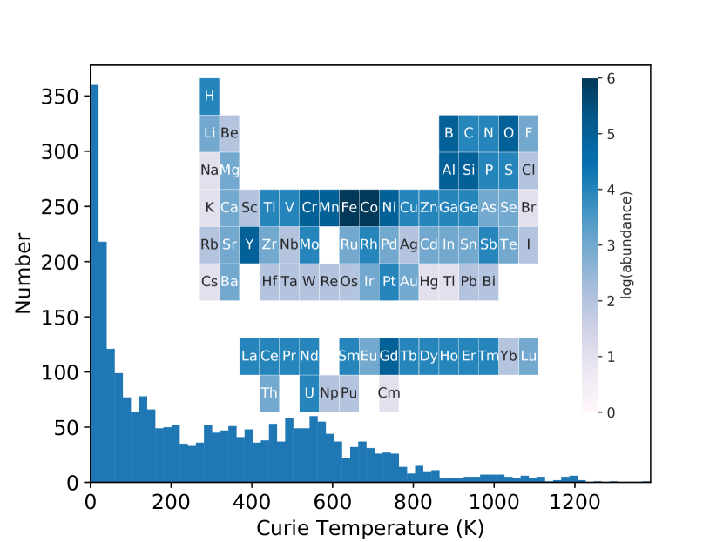
Common elements in Ferromagnets
A larger dataset was used to train ml models,this dataset is to show important elements.

Slide 6

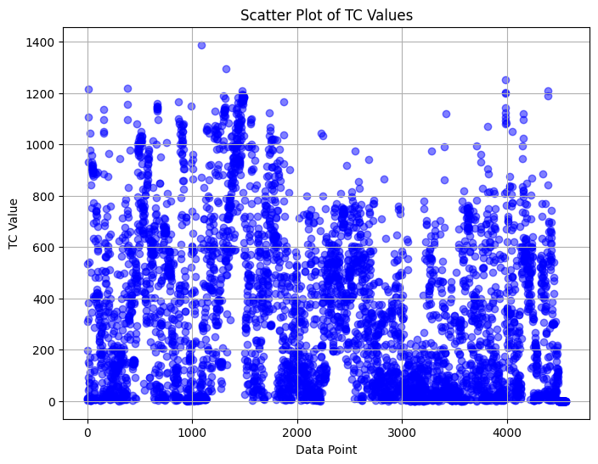
simple linear regression

Slide 7
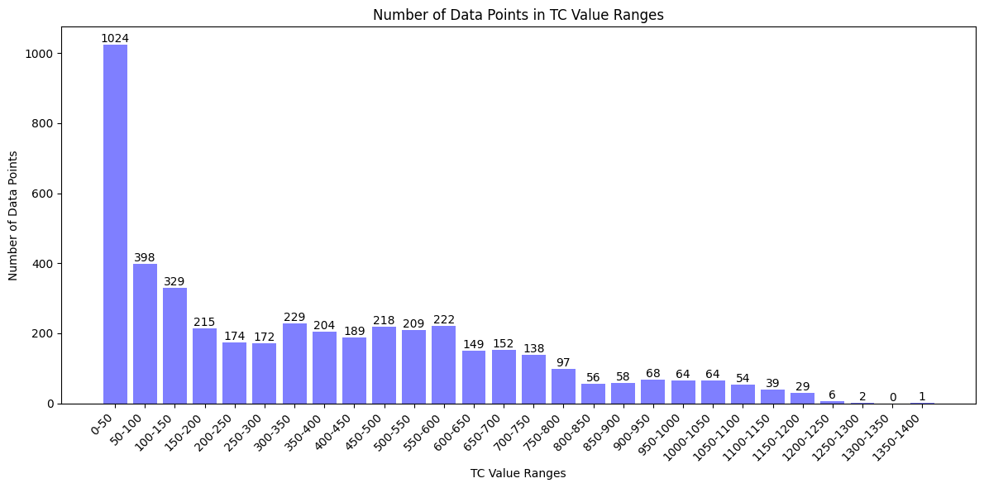
Data Visualization

Slide 8
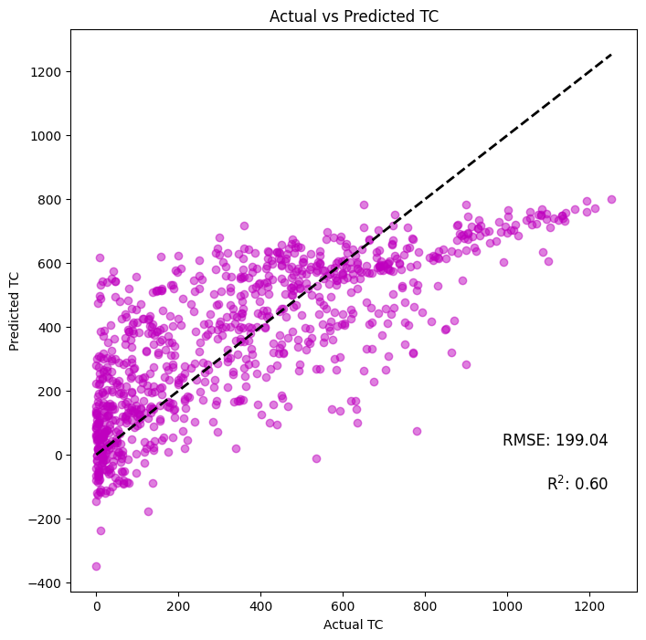
Simple
Linear
Regression Model

Slide 9

Regularized
Linear
Regression Model
(Ridge)

Slide 10
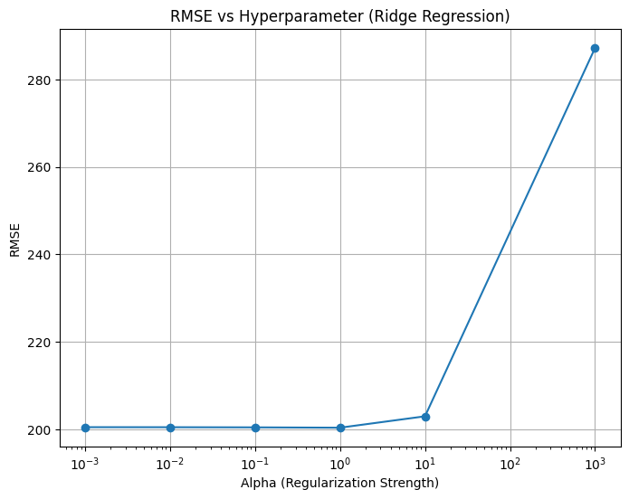
Regularized
Linear
Regression Model
(Ridge)
𝞪=1

Slide 11
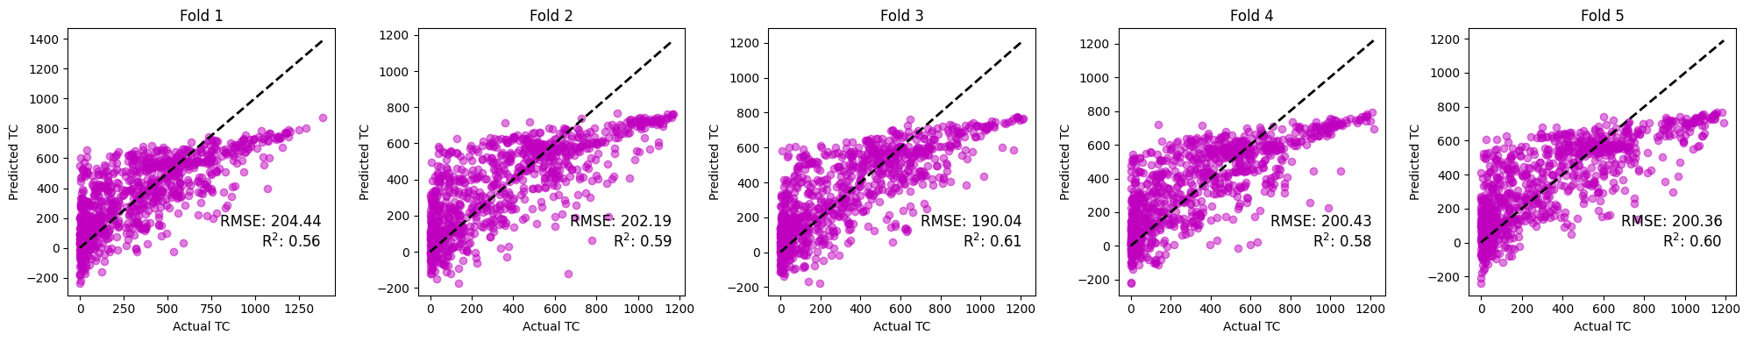
Ridge regularized
Linear Regression
5 fold
Cross-validation
Avg rmse=199.2
Avg r2=0.59

Slide 12
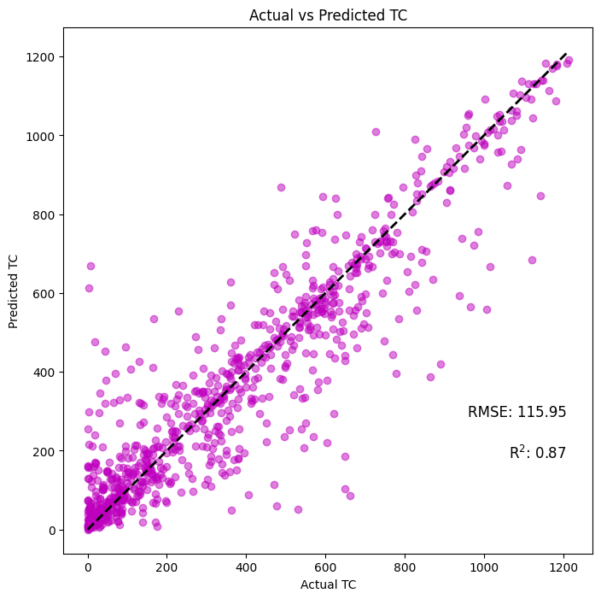
Random Forest Model

Slide 13
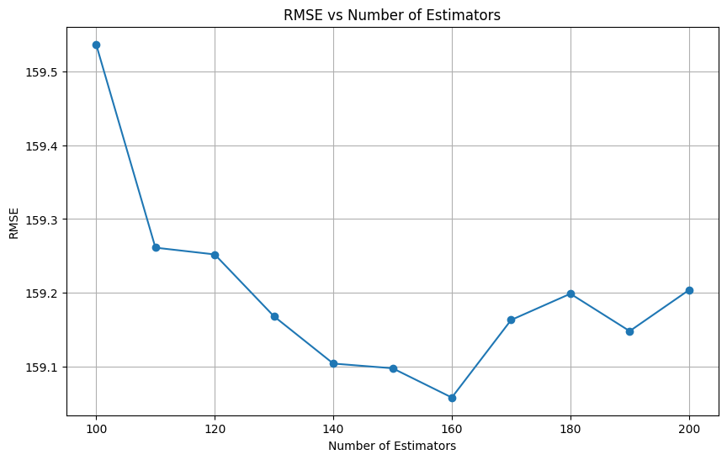
Random forest model
optimum #estimators =162

Slide 14
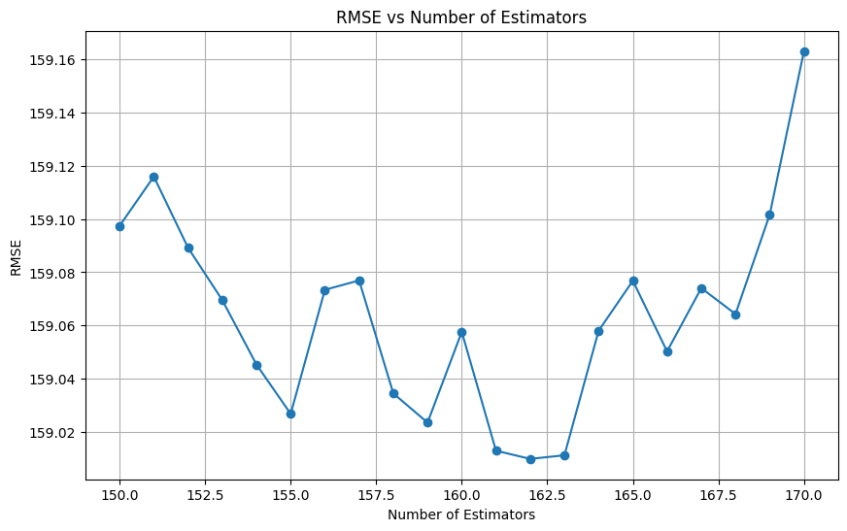
Random forest model
optimum #estimators =162

Slide 15
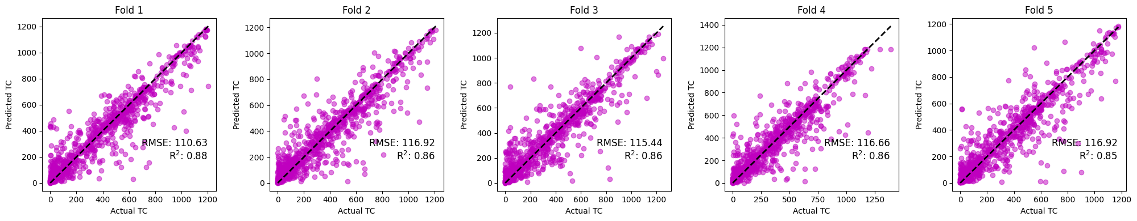
Random
Forest Model
5 fold
Cross-validation
Avg rmse=115.32
Avg r2=0.862

Slide 16
Conclusions
Random Forest model is able to handle non linear correlations better and is more accurate than regularised Linear Regression.
There is a large uncertainty ,more than 100 degrees celsius of any model predictions of curie temperature.
To find useful Ferromagnets for use in engineering purposes ,high Tc is necessary. The ML models developed will help accelerate research by helping to find candidates faster than ab inito or DFT calculations.

Slide 17
Refferences
https://github.com/msg-byu/ML-for-CurieTemp-Predictions
https://pubs.acs.org/doi/10.1021/acs.chemmater.3c00892
https://ar5iv.labs.arxiv.org/html/1906.08534
https://www.sciencedirect.com/science/article/pii/S0927025619303489
https://en.wikipedia.org/wiki/Curie_temperature
chat.openai.com

Slide 18
Thank You

